Slide 1
Nutrition Study
Mariah Bastos and Andrea Gonzalez

Slide 2

Contents
Introduction
Motivation and Purpose
Data Description
Installing and Loading the Data
Problem Statement
Hypothesis
Models and Methods
Visualizations
Conclusion

Slide 3
Introduction
In the following analysis, we will be analyzing in particular the relationship between calorie intake, fat, and fiber to determine if the cholesterol level can be predicted.
We will also analyze and test the relationship of cholesterol intake within gender.

Slide 4
Motivation and purpose
According to the American Heart Association:
46% of adults in the U.S. are estimated to suffer from hypertension.
On average, someone dies from CVD every 38 seconds.
Last year there were 389.4 deaths reported from a stroke each day.
Health is important and everyone should care about their health.
Our purpose with this study is for people to be aware about the consequences that an unhealthy diet can cause. To show them which factors increase their cholesterol so they can be conscious about it, take a proactive approach to solve this problem and keep healthy.

Slide 5

Data Description
We will be looking at a nutrition study which can be found on lock5stat.com.
This is an observational study of 315 candidates.
Female: 273
Male: 42

Slide 6
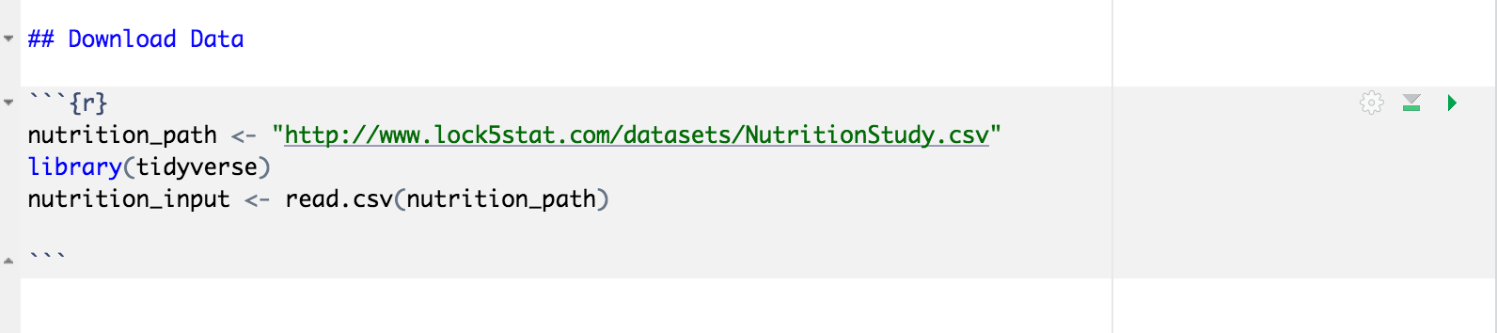
Installing Packages and Loading the data

Slide 7
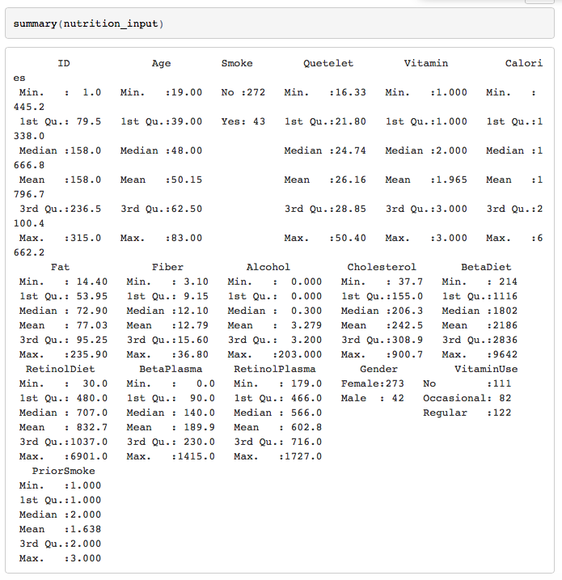
Data Summary

Slide 8
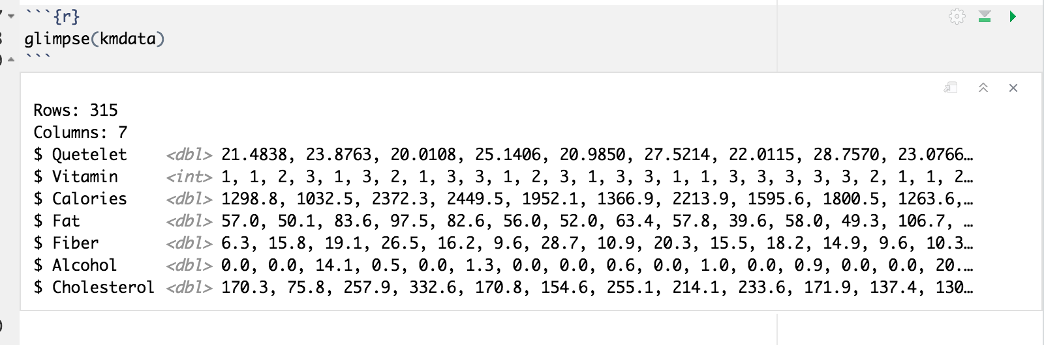
Used glimpse() to be able to see all columns in the data frame
Notes:
glimpse() is used to

Slide 9
Problem Statement:
Can we predict the cholesterol level by analyzing calories, fat and fiber intake?

Slide 10

Hypothesis Analysis
Null Hypothesis(H0):
There is a significant relationship between calories, fiber and fat intake that help us predict cholesterol level.
Alternative Hypothesis(H1):
There is not a significant relationship between calories, fiber and fat intake that help us predict cholesterol level.

Slide 11
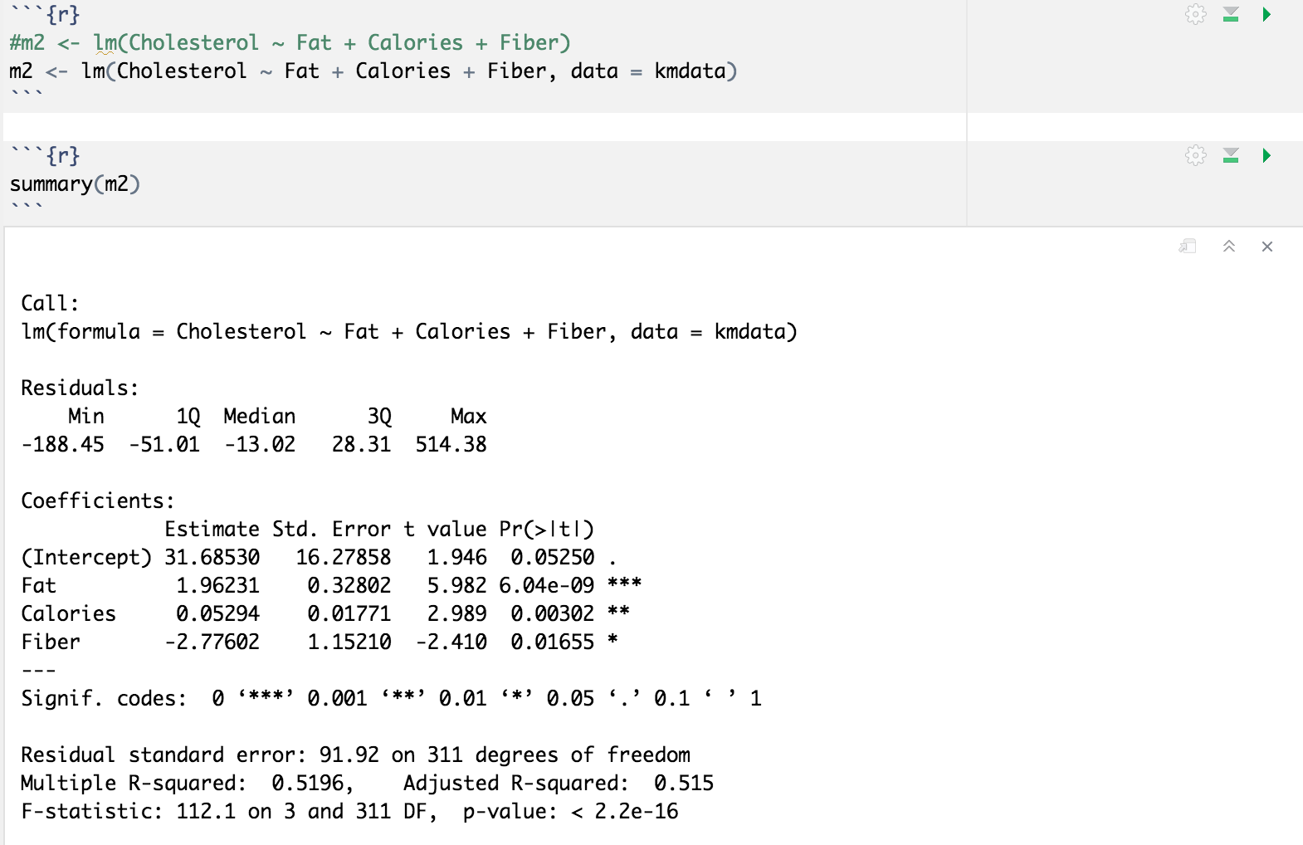
Linear Model
Notes:
The Linear Model will help predict cholesterol levels based on the data.

Slide 12
Results:
Adjusted R squared is 0.51
This means that the regression explains 51% of the variance between fat, calories and fiber.
P Value is less than alpha, thus we reject the null hypothesis.
There is not sufficient evidence to claim that there is a significant relationship between fat, calories and fiber that can help us predict the cholesterol level.
Notes:
Adjusted R squared is 0.51
This means that the regression explains 51% of the variance between chol, fat, cal and fiber.
P Value is low, therefore is not significant
F Statistic is 112, with 3 degrees of freedom and 311 observations (317 minus parameters in regression)

Slide 13
Linear Method
Visualizations

Slide 14
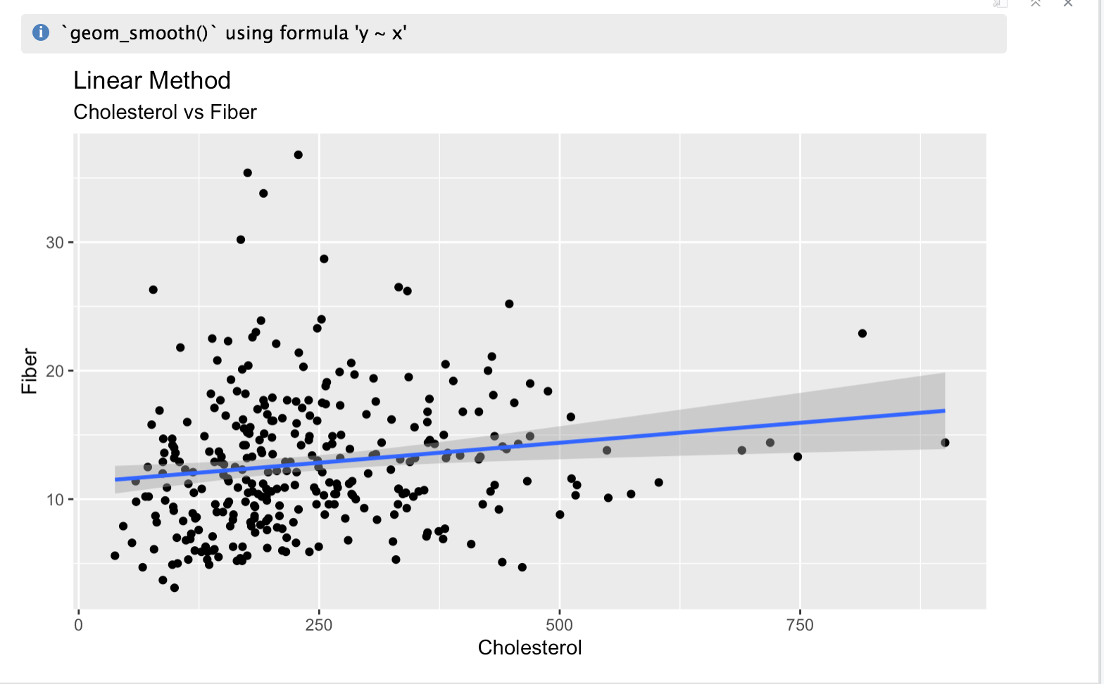
Cholesterol and Fiber
Notes:
FLAT DATA

Slide 15
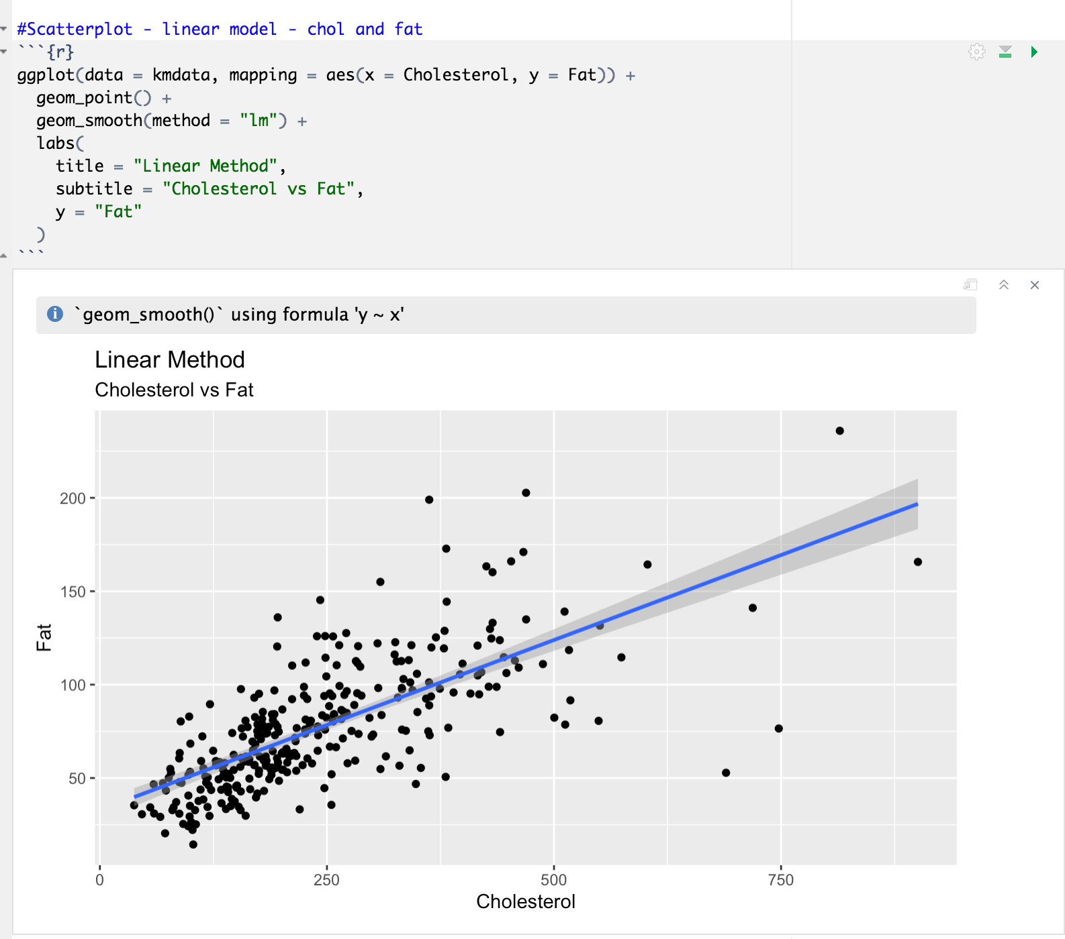
Cholesterol and Fat
Notes:
the data show an uphill pattern as you move from left to right, this indicates a positive relationship between X and Y. As the X-values increase (move right), the Y-values tend to increase (move up).

Slide 16
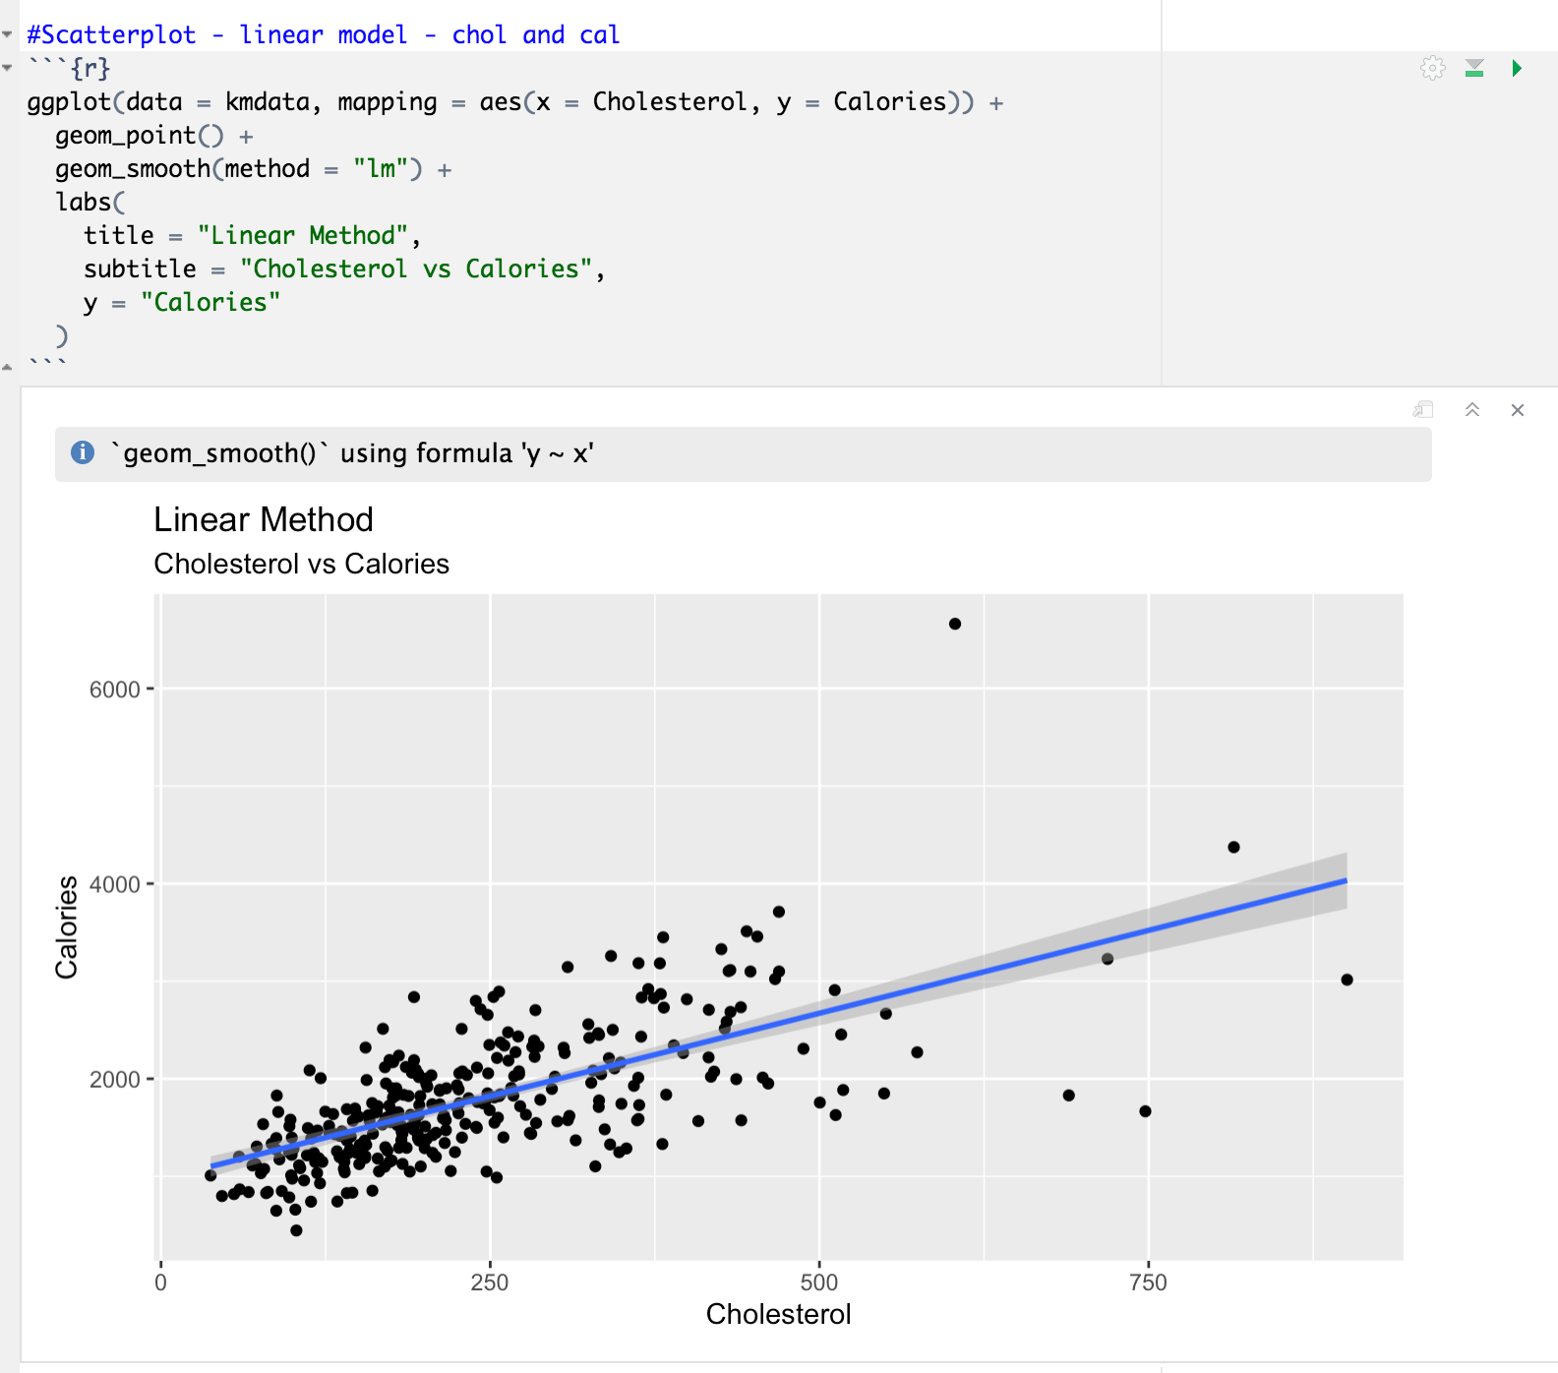
Cholesterol and Calories
Notes:
the data show an uphill pattern as you move from left to right, this indicates a positive relationship between X and Y. As the X-values increase (move right), the Y-values tend to increase (move up).

Slide 17
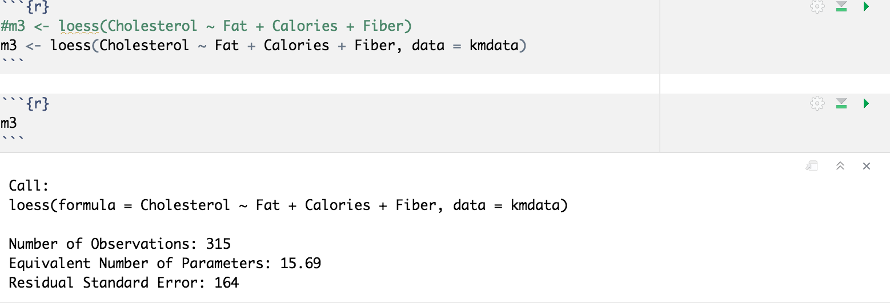
Loess Model

Slide 18
Loess Method
Visualizations

Slide 19
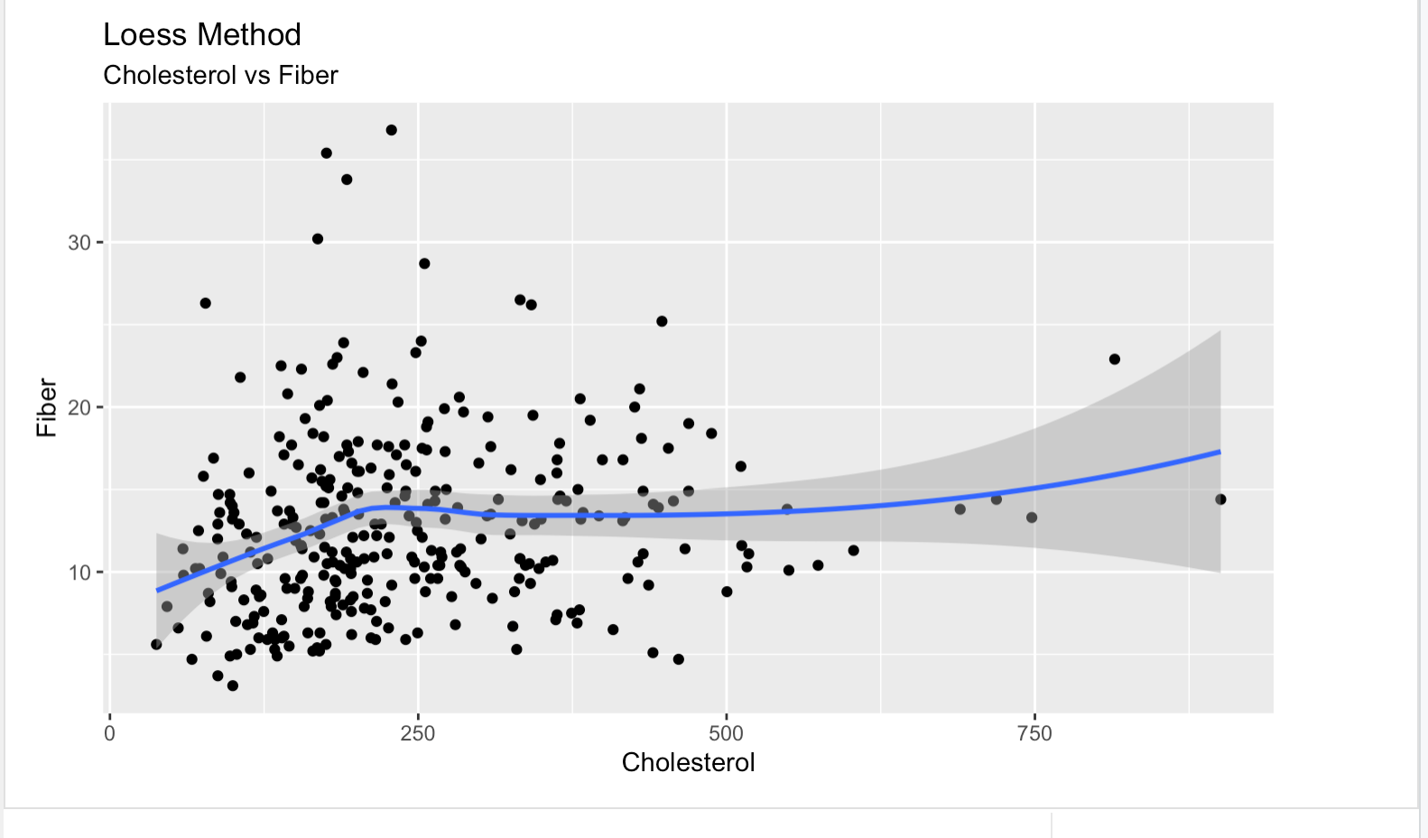
Cholesterol and Fiber
Notes:
The Linear Model will help predict cholesterol levels based on the data.
Adjusted R squared is 0.51
This means that the regression explains 51% of the variance between chol, fat, cal and fiber.
P Value is low, therefore is not significant
F Statistic is 112, with 3 degrees of freedom and 311 observations (317 minus parameters in regression)

Slide 20
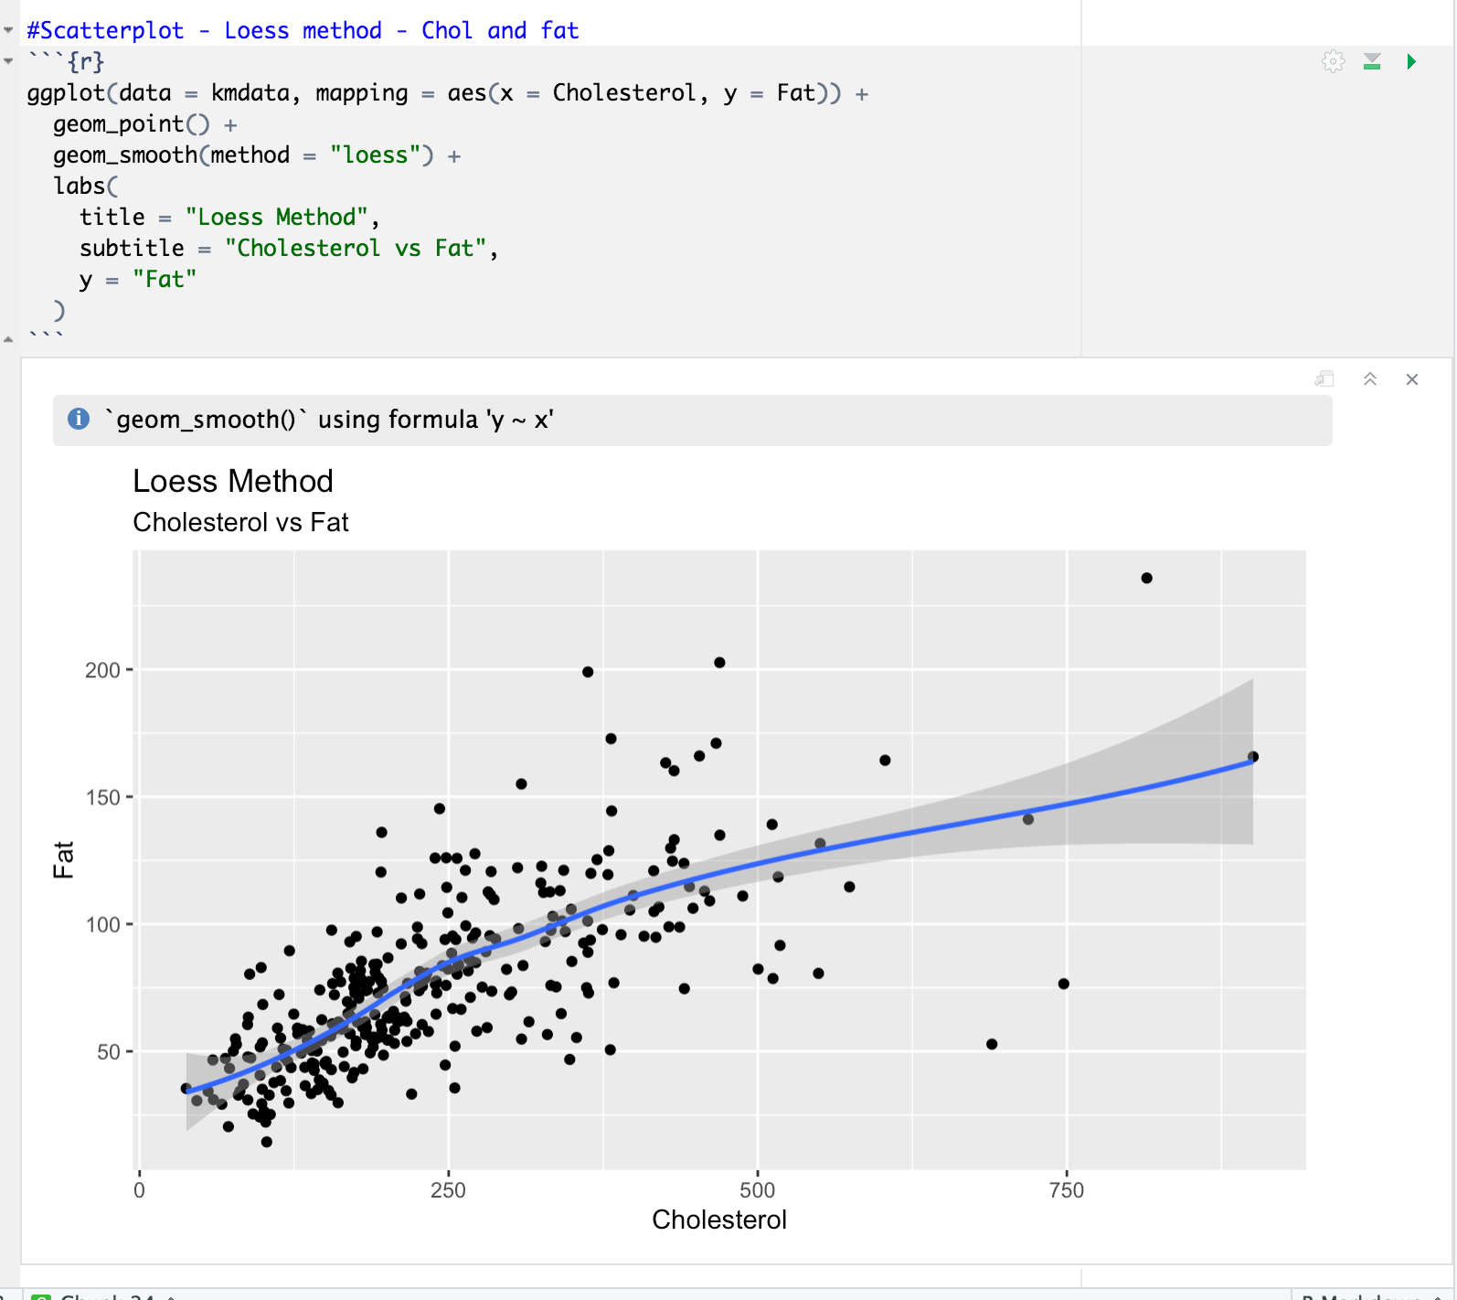
Cholesterol and Fat
Notes:
The Linear Model will help predict cholesterol levels based on the data.
Adjusted R squared is 0.51
This means that the regression explains 51% of the variance between chol, fat, cal and fiber.
P Value is low, therefore is not significant
F Statistic is 112, with 3 degrees of freedom and 311 observations (317 minus parameters in regression)

Slide 21
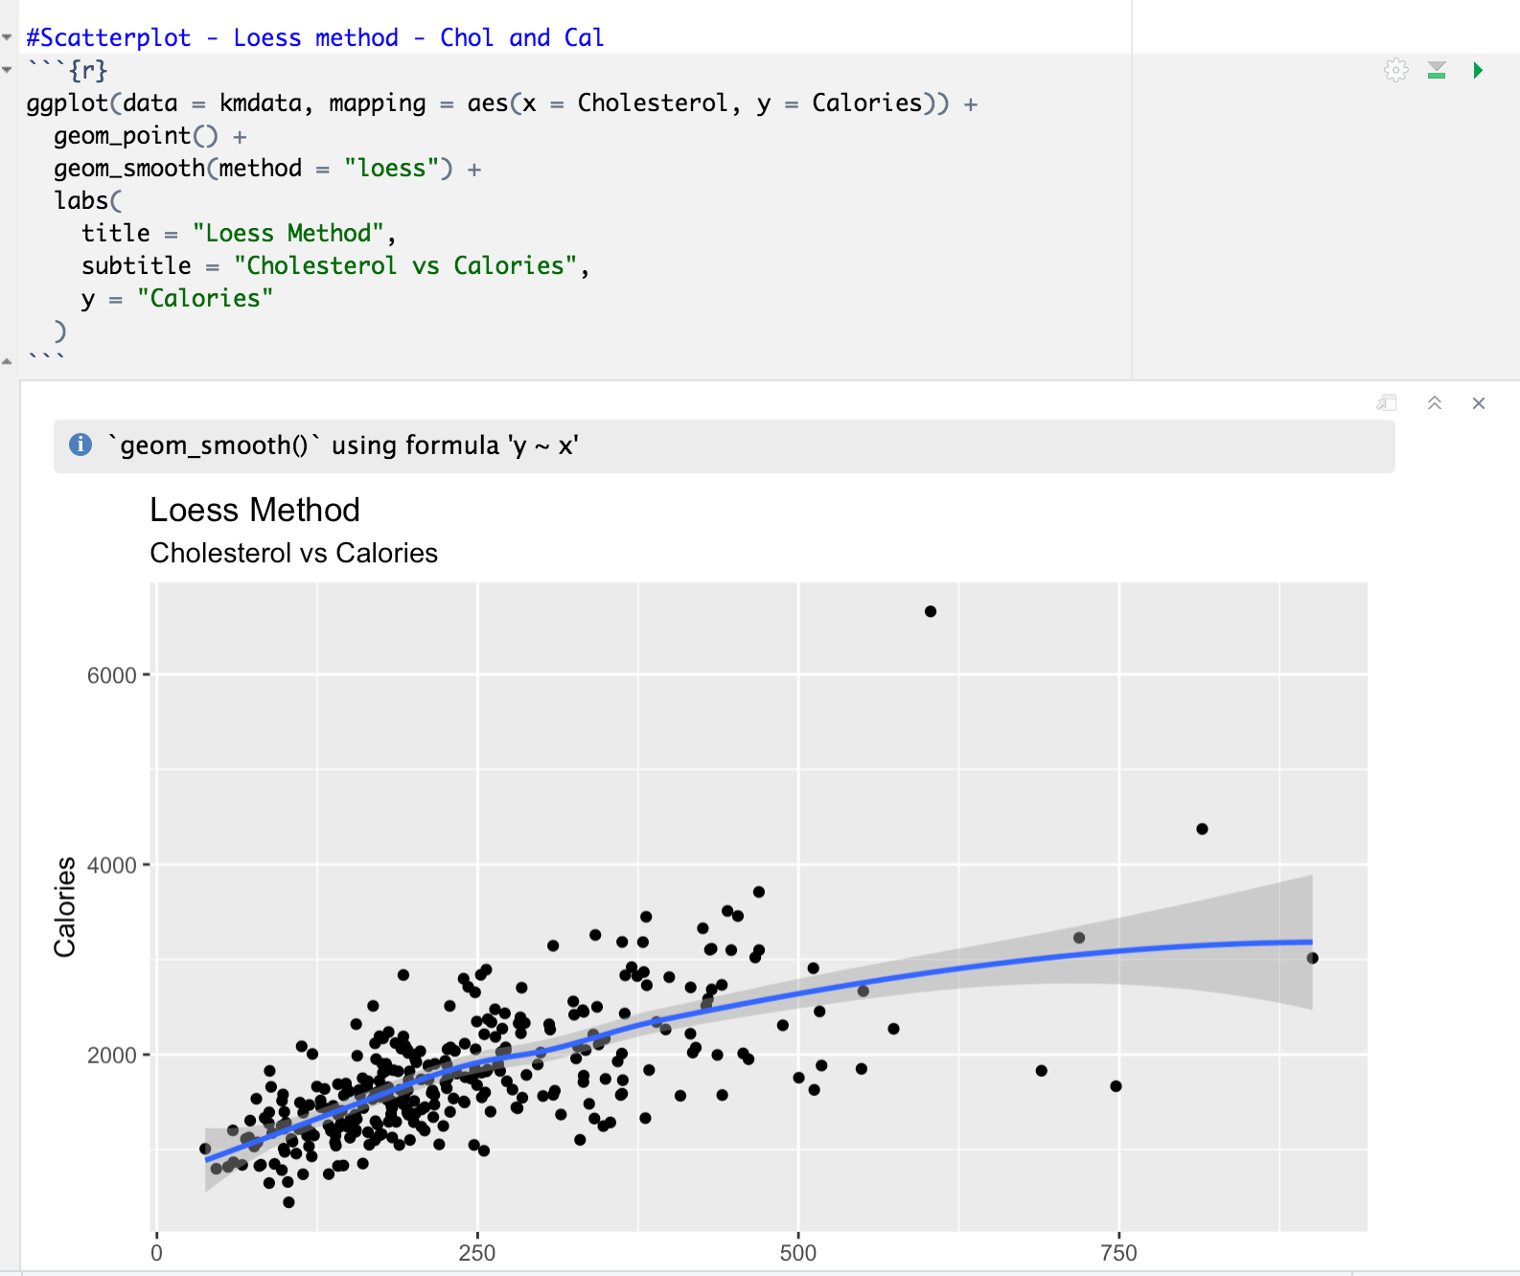
Cholesterol and Calories
Notes:
The Linear Model will help predict cholesterol levels based on the data.
Adjusted R squared is 0.51
This means that the regression explains 51% of the variance between chol, fat, cal and fiber.
P Value is low, therefore is not significant
F Statistic is 112, with 3 degrees of freedom and 311 observations (317 minus parameters in regression)

Slide 22
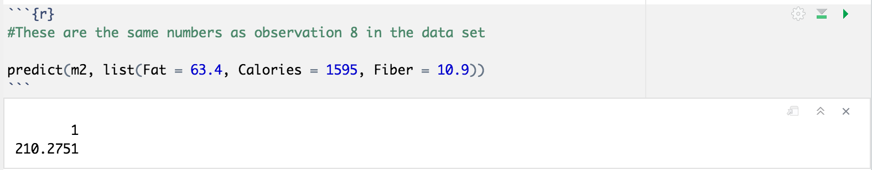
Prediction of cholesterol
The result of the prediction showed a cholesterol level of 210.27
The data showed a cholesterol level of 214.1 for this observation.
Not a perfect prediction, but not too far off.
Notes:
using the predict function we can predict the cholesterol level

Slide 23
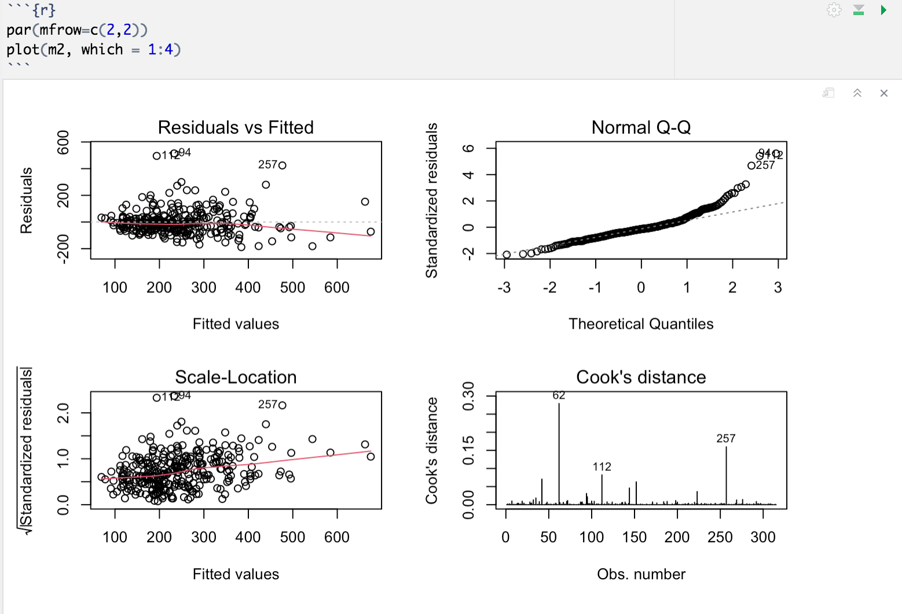
Variable combination using Pairs
Notes:
THIS GRAPHICS GIVE US A PLOT MATRIX CONSISTING OF SCATTERPLOT FOR EACH VARIABLE COMBINATION

Slide 24
Observations
Residual = observed y - predicted y
There are a few observations in our case which are throwing off this model.
For example, observation 257 is problematic for my description. This case has a cholesterol of 900, which is extremely high no matter age or gender.
The Scale location plot (square-root standardized residual vs. predicted value) shows more linearity, however with the same outliers.
The Q-Q plot shows relatively good normality, although the fit strays toward the top.
Observation 62 had an extremely high calorie intake (6660).

Slide 25
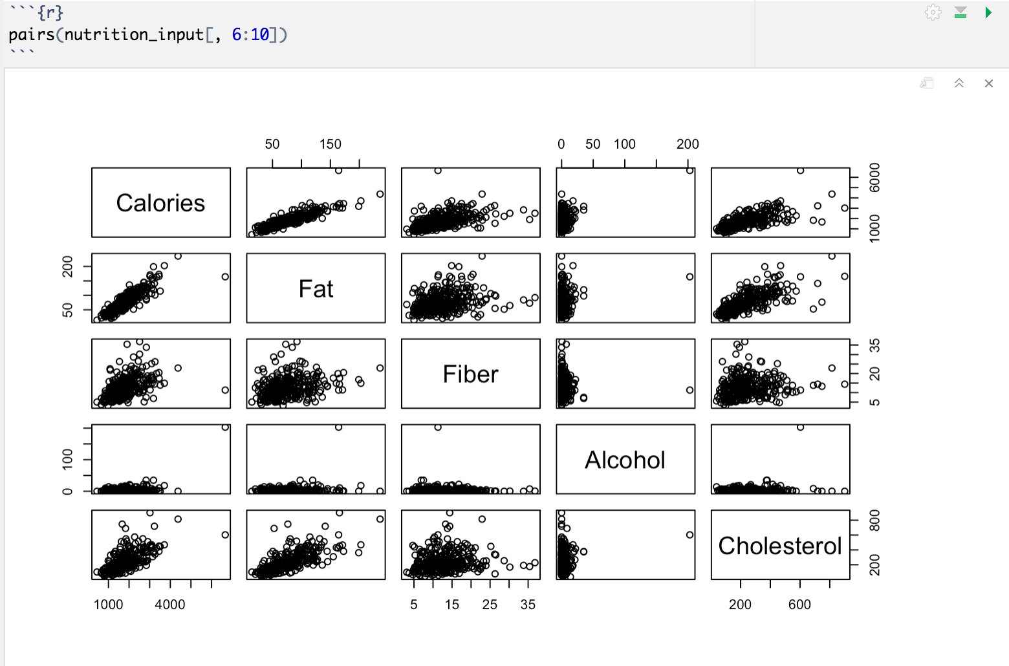
Variable combination using Pairs
Notes:
THIS GRAPHICS GIVE US A PLOT MATRIX CONSISTING OF SCATTERPLOT FOR EACH VARIABLE COMBINATION
These graphs show that there is a positive correlation between cholesterol and both fat and calories.

Slide 26
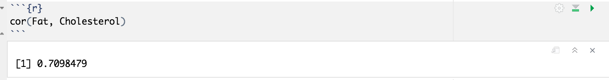
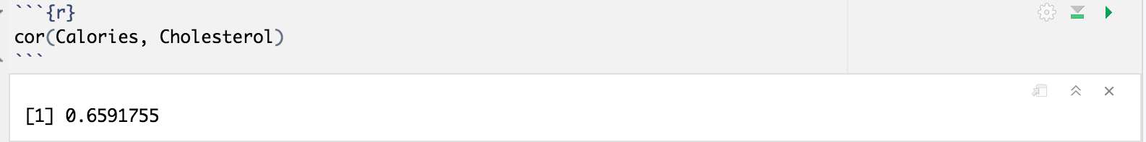
Correlation
Fat and Cholesterol
Calories and Cholesterol
71% and 66% correlation.

Slide 27
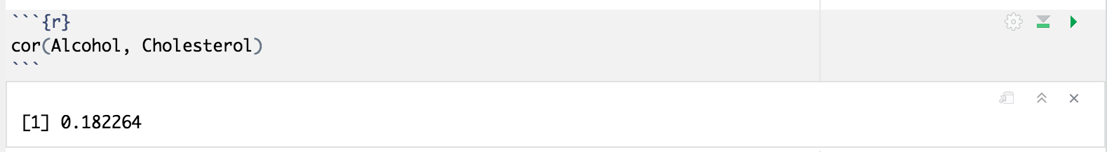
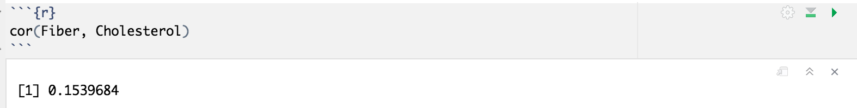
Correlation
Alcohol and Cholesterol
Fiber and Cholesterol
18% and 15% correlation
Results:
People who have a higher intake of fat and calories, tend to have higher cholesterol.
Fiber and alcohol are not correlated.

Slide 28
Hypothesis Analysis
Null Hypothesis(H0):
There is a significant relationship between the intakes of cholesterol according to gender
Alternative Hypothesis(H1):
There is not a significant relationship between the intakes of cholesterol according to gender

Slide 29

Testing for Normality

Slide 30
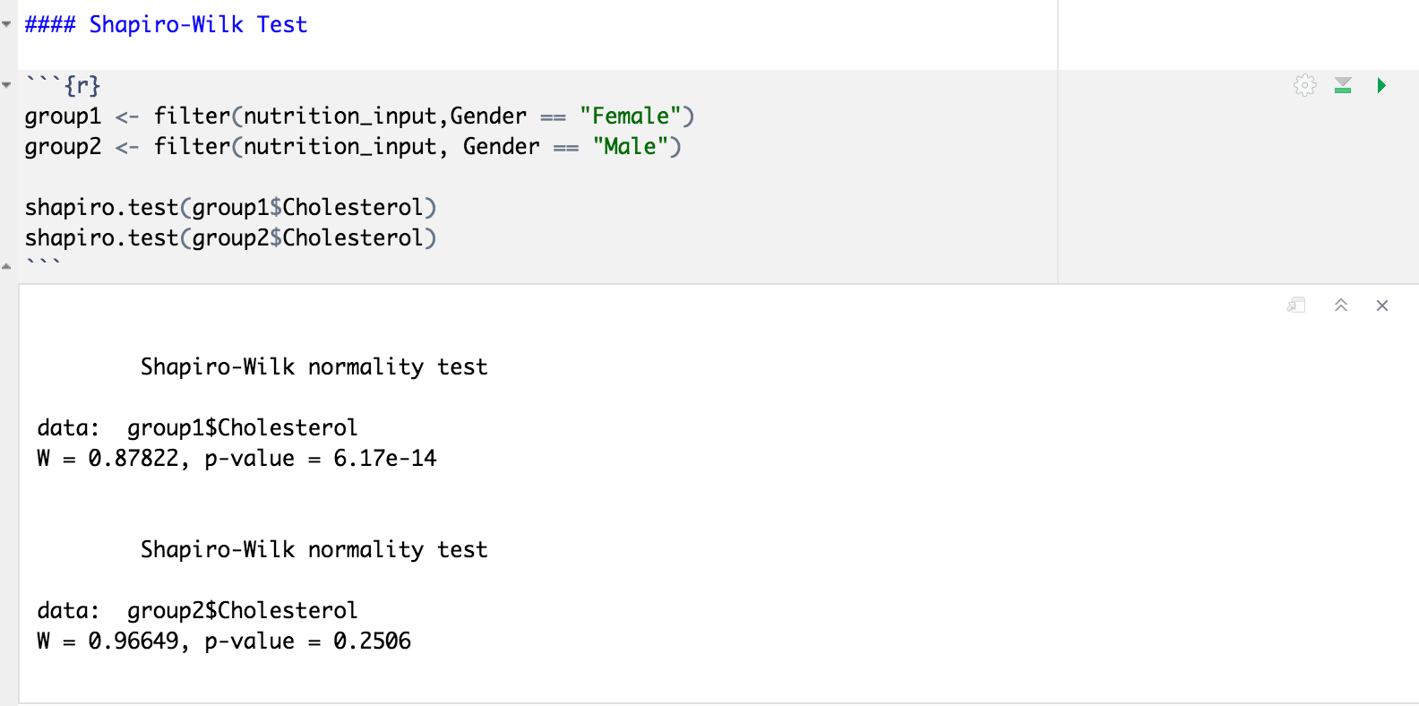
Shapiro-Wilk Test
For group 1 the P-value of 6.17e-14 is less than alpha, and for group 2 the P-value of 0.2506 is greater than alpha, thus the distributions are not normally distributed.
Notes:
The p-value for both groups is greater than alpha, thus the distributions are normally distributed.

Slide 31
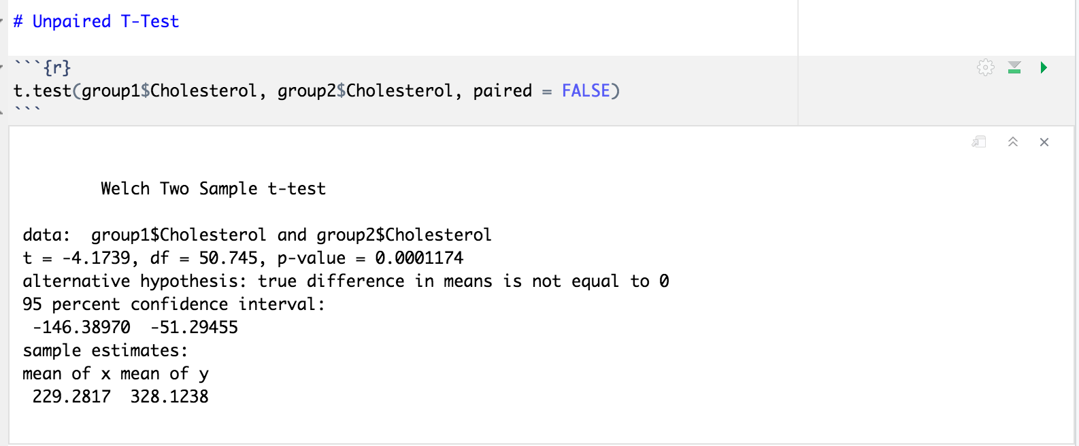
T-Test (Unpaired)
P-value of 0.0001174 is less than alpha, thus we reject the null hypothesis.
There is sufficient evidence that the means of both groups are significantly different.
Notes:
p-value of 0.006795 is less than alpha, thus we reject the null hypothesis. There is sufficient evidence that the means of both groups are significantly different.

Slide 32
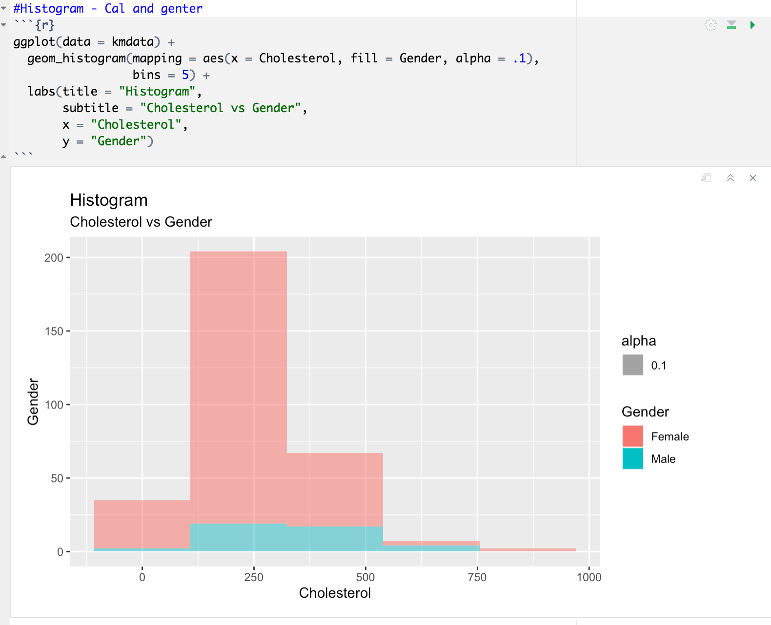
Histogram

Slide 33
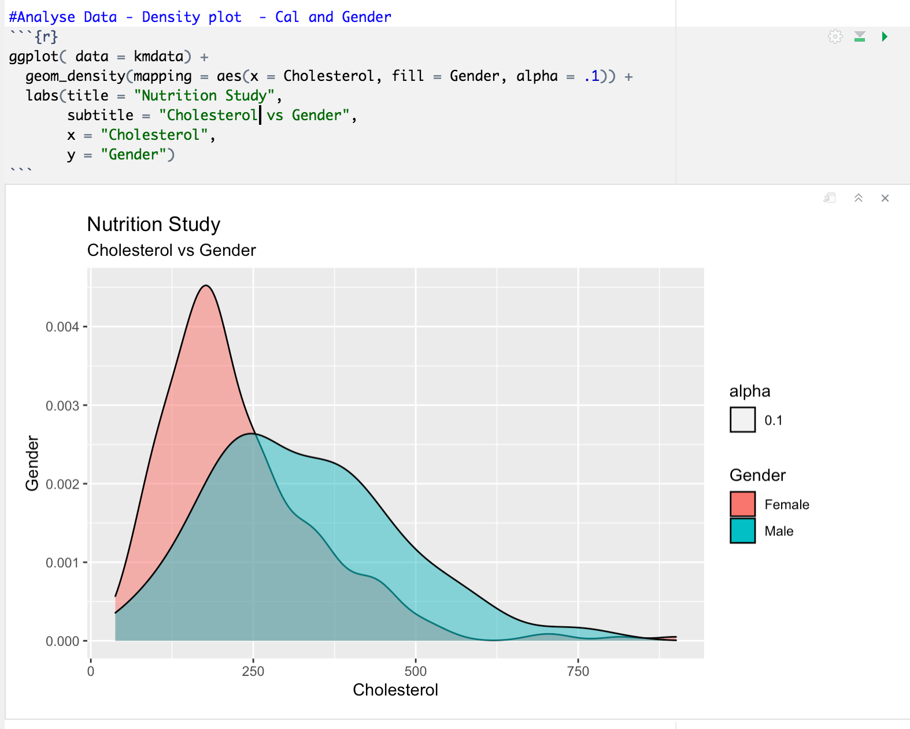
Density plot

Slide 34
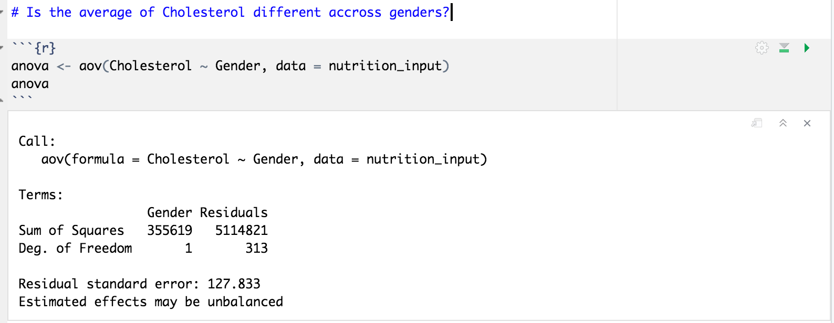
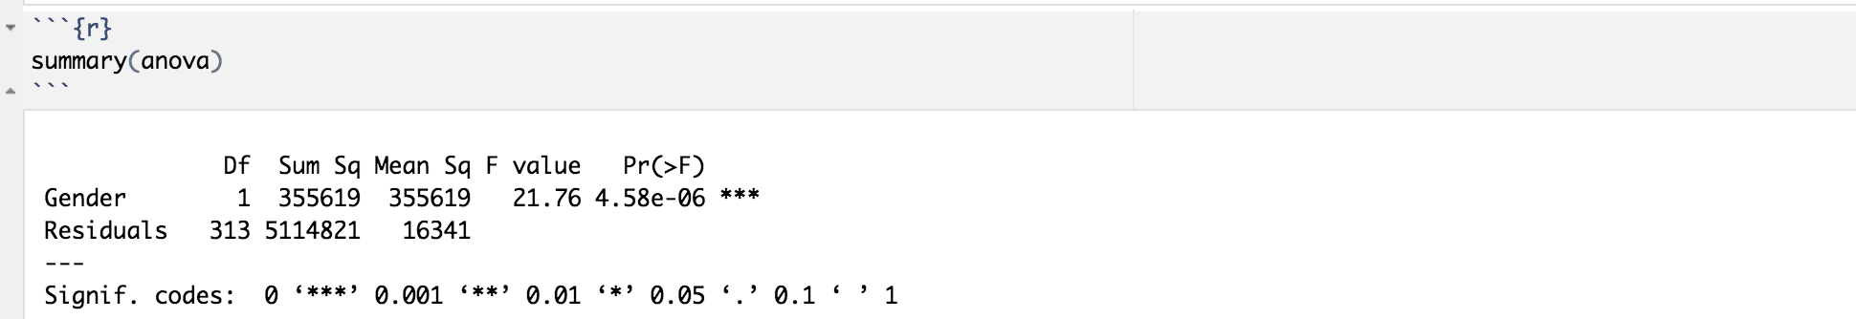
One Way Anova

Slide 35
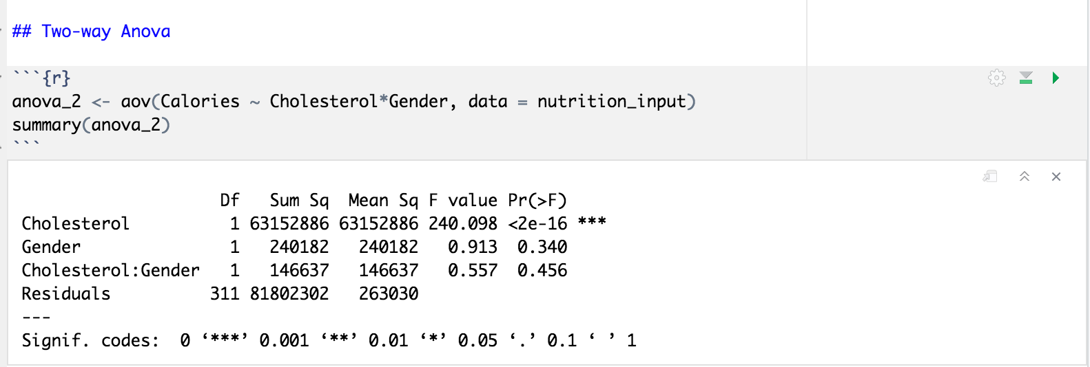
Two Ways Anova

Slide 36
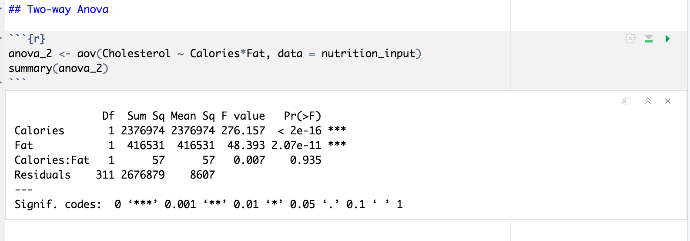

Slide 37
Results:
According to our normality test and our variance test, P Value is less than alpha, thus we reject the null hypothesis.
There is not sufficient evidence to claim that there is a significant relationship between cholesterol levels and gender.
Notes:
Adjusted R squared is 0.51
This means that the regression explains 51% of the variance between chol, fat, cal and fiber.
P Value is low, therefore is not significant
F Statistic is 112, with 3 degrees of freedom and 311 observations (317 minus parameters in regression)

Slide 38
Conclusion
From our first hypothesis our P-value results were lower than alpha, thus we were not able to prove our null hypothesis right. We conclude that there is not a significant relationship between cholesterol and the intake of fat, fiber and calories.
From our second hypothesis our P-values also resulted lower than alpha, thus we were not able to prove our null hypothesis right. It can also be concluded that there is not a significant relationship between cholesterol levels within gender.
A limitation of variables observed were the outliers. It would be better to leave out these observations to create a better fit and prediction.
This project put into practice what I have learned throughout the term and helped me to better understand the correlation between variables.
Notes:
It can be concluded that higher intakes of fat and calories will result in higher cholesterol levels. Alcohol and fiber did not have a significant effect on cholesterol levels.

Slide 39
References
(2012). Lock5stat.Com. http://www.lock5stat.com/datasets/NutritionStudy.csv
‌

